Slide 1


Baltimore Crime Data
Ion Barbus

Slide 2
The Project
With 58 murders per 100,000 residents in 2019, Baltimore is the deadliest U.S. city with more than 500,000 residents…
In comparison: Guatemala, El Salvador and Honduras posted murder rates in 2019 of 21.5, 36 and 41.2 per 100,000 residents, respectively. *
Analyzing crime data in Baltimore to understand key predictors of crime
Based on historical data, can we forecast crimes for years to come?
* Kennedy, Sean. “'The Wire' Is Finished, but Baltimore Still Bleeds.” The Wall Street Journal, Dow Jones & Company, 7 Feb. 2020, www.wsj.com/articles/the-wire-is-finished-but-baltimore-still-bleeds-11581119104.

Slide 3
Goal
Forecast crime data
Predict unusual spikes in crime
Identify at risk neighborhoods
Identify predictors of crime

Slide 4
Dataset Preparation
Clean up location format
Derive entries from start and end dates
Change Data Objects
Handle incomplete data

Slide 5
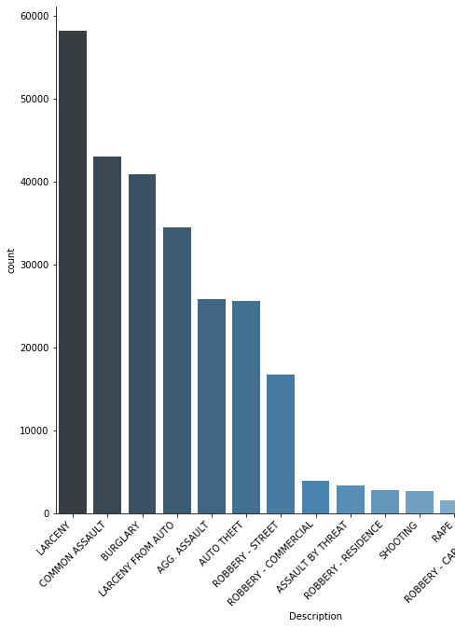
Analysis
Larceny, common assault and burglary are the three most common descriptions of crime
The most criminal locations are in the Northeastern and Southeastern districts
Most used weapon are hands, followed by firearm and then knife

Slide 6
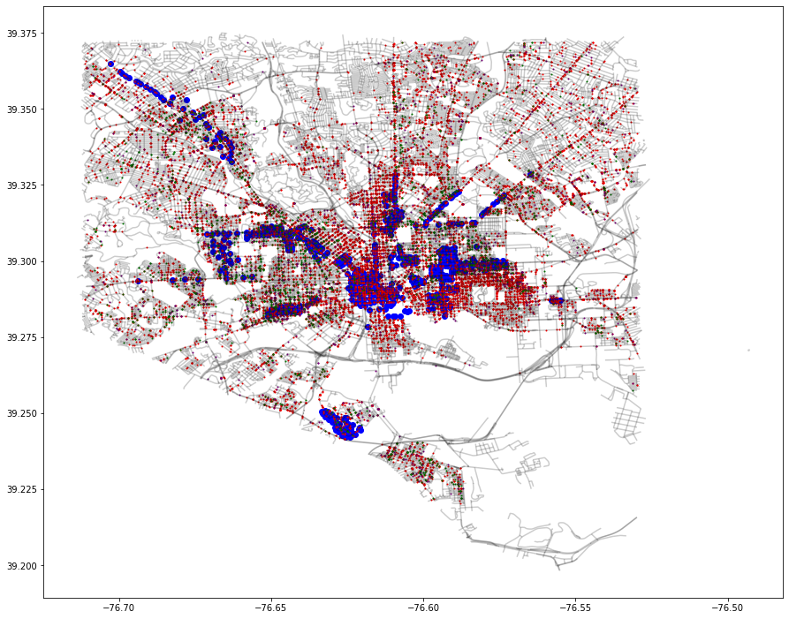
GeOAnalysis
Geopandas
Plot Coordinates
DBSCAN for hotspot detection

Slide 7
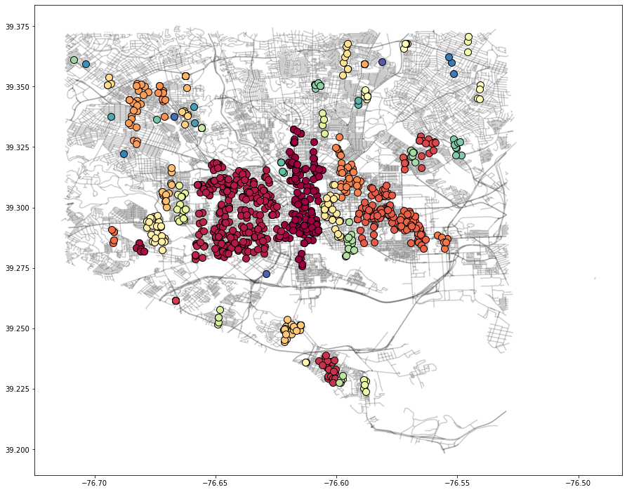
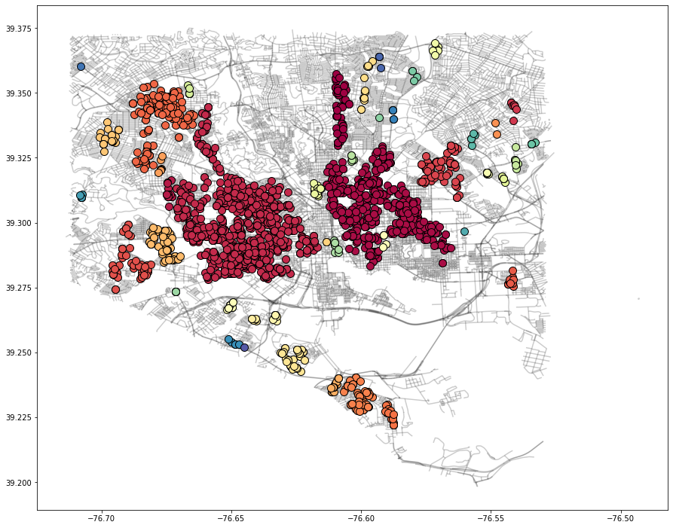
Geo Model
Rape
Shooting

Slide 8
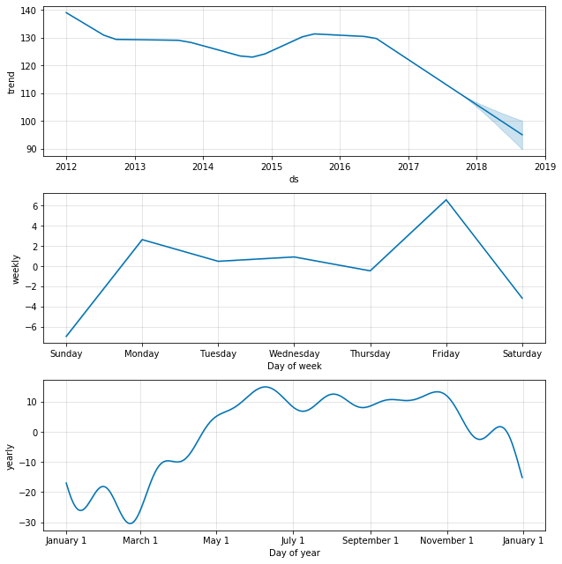
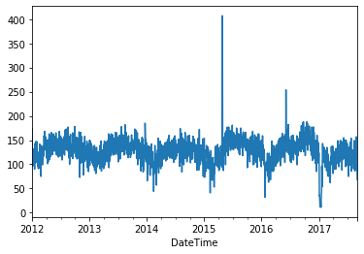
Timeseries analysis

Slide 9
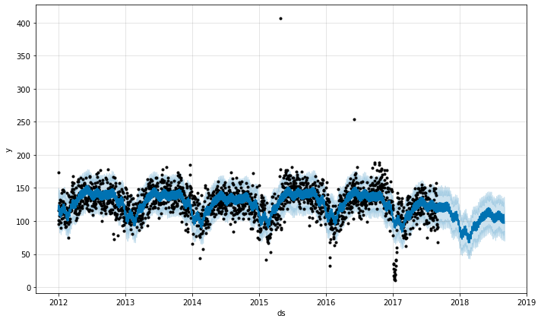

Timeseries Forecasting
Model with no Holiday
Forecasting crime in Baltimore
Included Regressors
Holidays
Accuracy of models

Slide 10
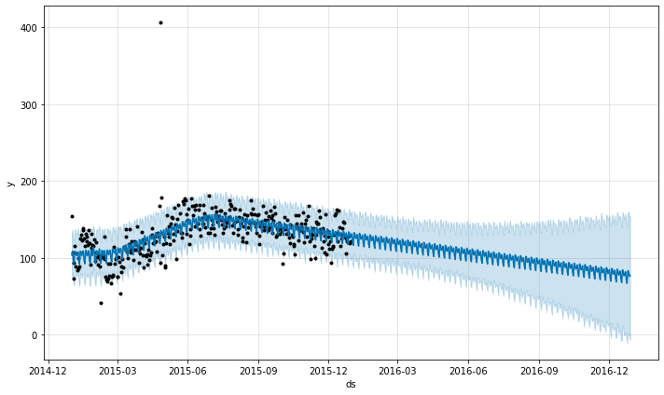
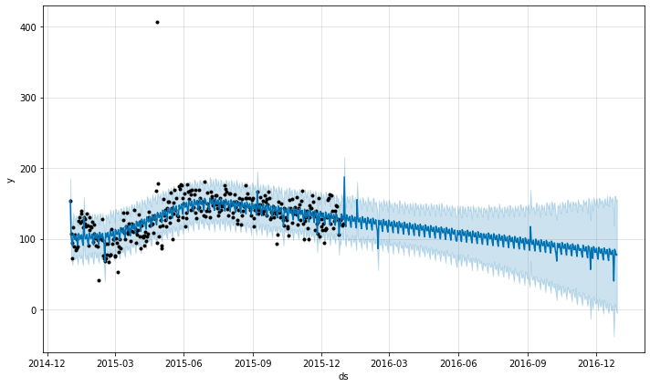
Adding Event Dataset to Model
Baseline Model MAPE: 11.5439
Event Model MAPE: 11.4828
Event
Baseline

